Slide 1

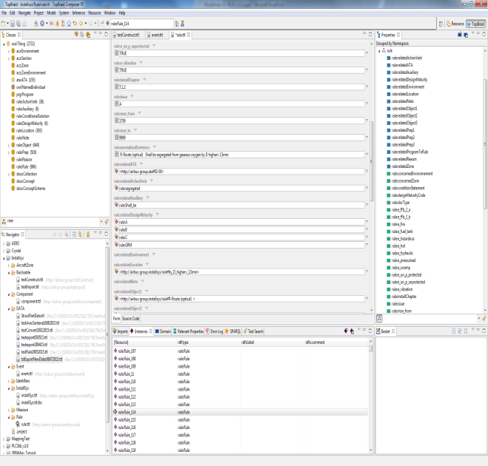
UC-FR-03 Synchronization of regulation documentation with a design rule repository
DRAFT
Status 1st iteration: synchronizing the SIDP KB content and text part
Thermal variation shall be taken into account
Structural deformation shall be taken into account
Pressurization Variation shall be taken into account
Component/Item/Object shall be qualified to withstand temperature reached by the routes they are in contact with
Model part = rule KB
Textual part = rule sentences

Slide 2
Component classes taxonomy
DRAFT
ObjectProperties
Component
Assembly
“Structural_Element”
subClassOf
“Bracket”
Physical component
Attachment device
“Fastener”
“Pclamp”
Clamp
AnnotationProperties
Rdfs:label
“Assembly”
Skos:prefLabel
P-Clamp
P-Clamp NSA5516

Slide 3
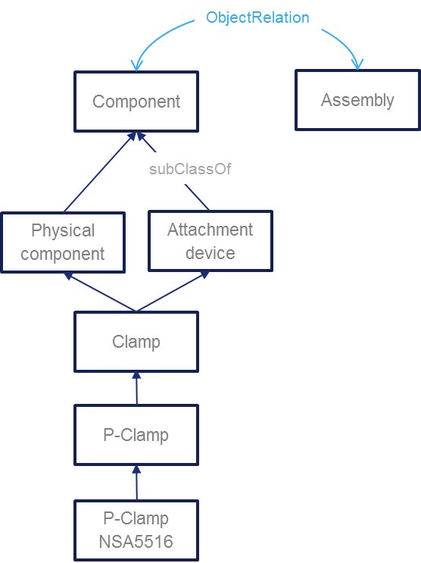
Component classes taxonomy
DRAFT
“P-clamp NSA5516 can be fixed on X with Y”
“Physical component”
“Standard reference”
NLP Parsing uses this taxonomy. Labels + assumptions such as a physical component may be referred to using its name or its reference or both concatenated
Inference rule: a rule applying to a component type (Attachment device) applies to its subtypes (P-clamp)
Document display : when searching rules applying to a component type (P-Camp) → retrieve and display rules applying to super-types

Slide 4
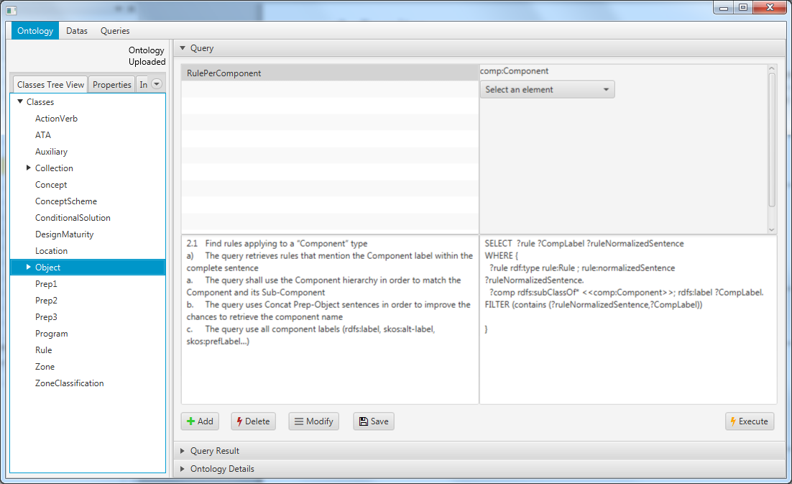
SPARQL queries
DRAFT
Status : model based queries specification
Preliminary study with Loria (Text to RDF)
1 internship on RDFizer and Query management

Slide 5
Thank you for your attention! Any question ?
DRAFT

